Slide 1

DriverPass System Analysis
Stephen Tyler Bailey

Slide 2

System Requirements
Functional Requirements
User Authentication
Lesson Scheduling
Nonfunctional Requirements
Accessibility
Scalability
Notes:
Functional Requirements
User authentication – the system will allow users to log in by entering a unique and valid username & password.
Lesson scheduling – the system will allow users to schedule, modify and cancel driving lessons through the user friendly interface
Nonfunctional Requirements
Performance – The system will provide real time responses to user interactions, with load times being sub 2 seconds during normal conditions
Security – the system will use encryption to secure all data exchanges between the user and the server. This will ensure all sensitive information is protected from unauthorized users.

Slide 3
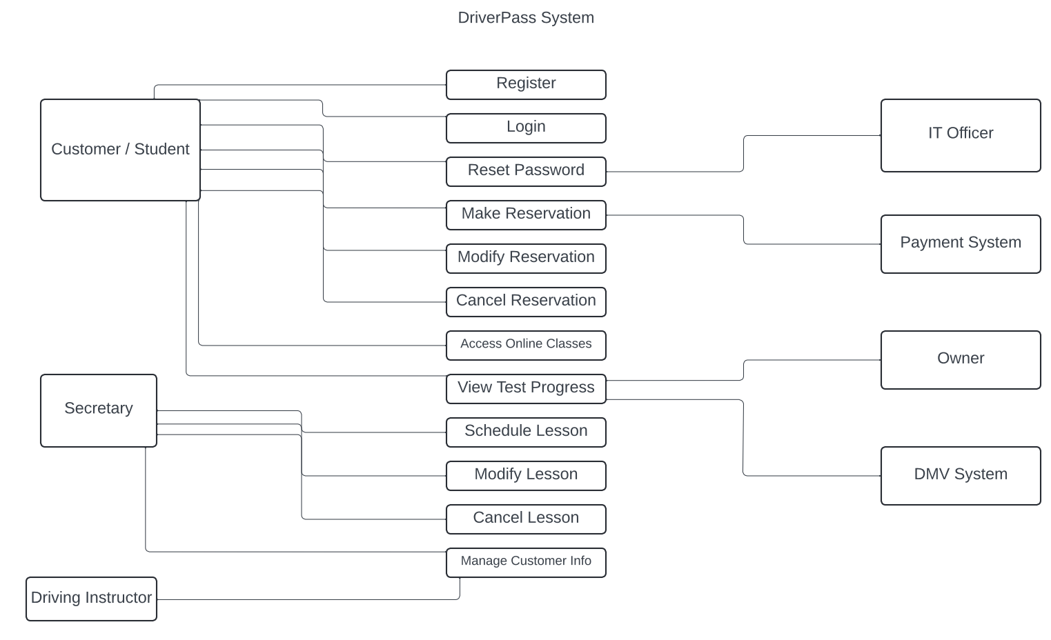
Use Case Diagram
[Insert your use case diagram here.]
Notes:
The key users are Customer(student), Secretary, Driving instructor, IT officer, Payment system, owner, and DMV system.
The main functionality
Registration and login – students & customers can register then log in to access the system
Password management – users can reset their password if they have forgotten them
Reservation management – customers can make, modify, or cancel reservations for driving lessons.
Access to learning materials – customers can access online classes and view their progress.
Lesson scheduling – secretaries and driving instructors can manage the scheduling of lessons.
Customer info management – the system allows secretaries to manage customer info to keep records up to date and accessible.
How to design to meet drivers passes needs
Create a user friendly interface to allow students to access learning material, schedule lessons, and track progress.
Administrative support allowing secretaries and admin roles to have tools needed to manage schedules and customer info.
Integration of external systems like payment system and dmv to ensure transactions are handled securely and learning material is always up to date.
Security and Maintance the IT officer is crucial for maintaining the security and integrity of the system.

Slide 4
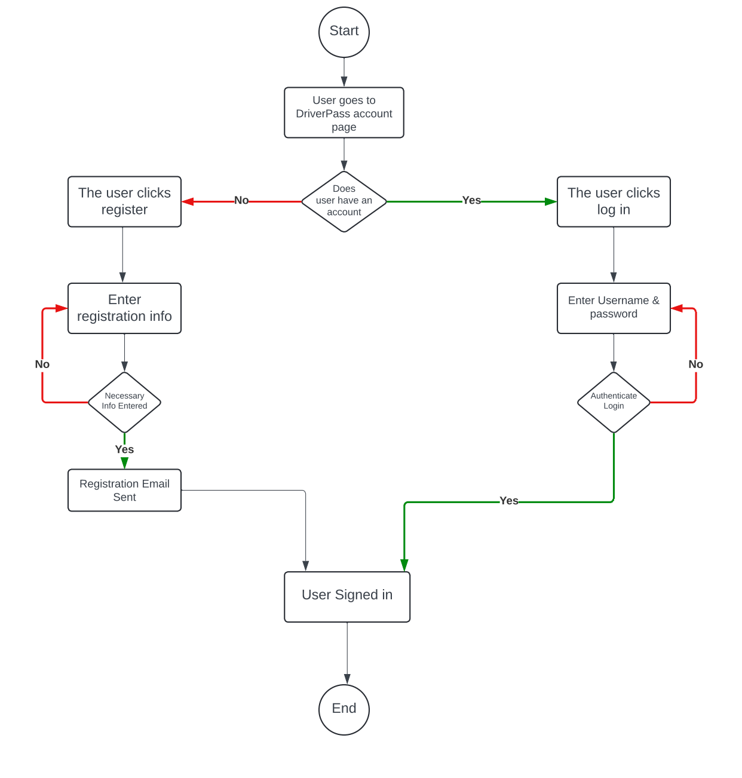
Activity Diagram
[Insert one of your activity diagrams here.]
Notes:
The figure shows the "User Authentication" process, which includes both the login and registration procedures. These stages are crucial in the DriverPass system as they decide how users may access their individual information and services. The procedure commences when the user directs themselves to the DriverPass account page. The system verifies whether the user already possesses an account. Non-registered users are prompted to create an account. On the other hand, if the user has an account, they will be led to the login procedure. When the user chooses to register, they are asked to provide their registration information. The system subsequently validates if all required information has been given. Once all the necessary information is provided, a registration email is dispatched to the user, indicating that the user is now officially signed in. However, if the user opts to log in, they must provide their username and password. The system verifies the accuracy of the login credentials, and upon successful validation, grants the user access to their account. The process is considered complete after the user has successfully signed in, regardless of whether they have logged in or established a new account. This design fits DriverPass's requirements by providing a user-friendly approach that effectively takes users through the required processes, whether they are signing in or enrolling for the first time. It integrates error management methods by using checks to validate user input before proceeding, hence minimizing mistakes and ensuring the system's security. The system sends a registration email to new users, serving the dual purpose of confirming their registration and enhancing security and communication.

Slide 5
Security
Account Verification
Information Validation
Registration Confirmation
Error Handling
Secure Account Access
Notes:
When the system was being made security was very important to make sure that user data is kept safe and that only people who are allowed to can access their accounts. To make sure the person is who they say they are, we took steps like checking account information during registration and login. We also sent a confirmation email during the signup process to make sure the user was who they said they were and stop anyone else from getting in without permission. We added an extra layer of security by asking users to enter information again when they got it wrong. This way, we can be sure that only real people can access their accounts and personal information.

Slide 6
System Limitations
Internet Dependency
User Familiarity
Scalability
Integration Complexity
Security Maintenance
Device Compatibility
Notes:
One problem with the design is that it needs a solid internet link to work, which could be a problem for people who don't have good connectivity. Further, the method believes that users are familiar with using the internet, which may not be the case for all of them. As more users use the system, it might need to be improved to keep running smoothly. It might also be hard to connect to outside systems like the DMV or payment providers. We made the system to work on a lot of different devices, but there may be times when it doesn't work right with older devices or sites that aren't used by many people.

